Slide 1
Welcome to TMRS:
Your Retirement Plan
City of Bellaire
Ida Gomez, Education Representative
January 10-11, 2024

Slide 2
TMRS Overview
TMRS is a statewide public retirement plan for participating cities’ employees
Founded in 1948
More than 933 participating cities
More than 220,000 active and retired Members

Slide 3
TMRS is Your Retirement Plan
You became a TMRS Member when you started working for the city
Notes:
If city does not have Restricted, remove first bullet and keep discussion to active service with other TMRS cities and Proportionate retirement

Slide 4
How TMRS Works: Contributions
You contribute 7% of your paycheck to TMRS
TMRS invests your contributions in its investment Trust Fund
Your contributions earn 5% interest annually
Notes:
Your account balance includes your contributions and interest you have earned on your balance. There is no limit on the amount of your TMRS benefit. Since it is based on your actual account balance and life expectancy at retirement, you continue to increase your benefit every month until you retire.

Slide 5
How TMRS Works: Service Credit
You receive service credit for each month you work for the city
You can also receive service credit for prior public service and military service
Notes:
Include city’s matching ratio in this discussion. Explain what an estimate is and that they are aware of MyTMRS. Let them know that they can run as many estimates as they want in MyTMRS and can call our office if they want an estimate that includes any changes. “We always recommend running an estimate for your birthday month because that is the month that your age changes in the life expectancy calculation. While your benefit increases every month, you will see a larger increase in your birthday month and you may want to consider waiting until that month to start drawing your benefit.

Slide 6
How TMRS Works: Vesting
You must have five years of service credit to vest in a TMRS benefit
Notes:
Include city’s matching ratio in this discussion. Explain what an estimate is and that they are aware of MyTMRS. Let them know that they can run as many estimates as they want in MyTMRS and can call our office if they want an estimate that includes any changes. “We always recommend running an estimate for your birthday month because that is the month that your age changes in the life expectancy calculation. While your benefit increases every month, you will see a larger increase in your birthday month and you may want to consider waiting until that month to start drawing your benefit.

Slide 7
How TMRS Works: Retirement Eligibility
Once you vest, you can receive a lifetime retirement benefit when:
  You reach age 60 with five years of service,
  OR
  You have 20 years of service at any age
Notes:
Include city’s matching ratio in this discussion. Explain what an estimate is and that they are aware of MyTMRS. Let them know that they can run as many estimates as they want in MyTMRS and can call our office if they want an estimate that includes any changes. “We always recommend running an estimate for your birthday month because that is the month that your age changes in the life expectancy calculation. While your benefit increases every month, you will see a larger increase in your birthday month and you may want to consider waiting until that month to start drawing your benefit.

Slide 8
Three Retirement Benefit Options
Retiree Life Only
  Provides a lifetime benefit to you
Retiree Life and Survivor
  Provides a lifetime benefit to you and then to your beneficiary
Retiree Life and Guaranteed Term
  Provides a lifetime benefit to you and possibly a benefit to your beneficiary
Notes:
A Cost-of-Living Adjustment, or COLA, is an increase to your monthly benefit based on inflation. Your city provides increases based on ENTER PERCENTAGE of the inflation rate. You must be retired for a full year to receive a COLA and the amount will vary every year.

Slide 9
Partial Lump Sum Distribution
In addition, you can choose to receive a Partial Lump Sum Distribution from your retirement account

Slide 10
How Your Benefit Is Calculated
Your TMRS retirement account includes your cash contributions and your annual interest earnings
When you retire, your account balance is matched by the city 2:1
Your monthly retirement benefit is calculated based on your total account balance and life expectancy at retirement

Slide 11
Your City’s Additional Benefit Options
Supplemental Death Benefit
Updated Service Credit
Cost of Living Adjustments

Slide 12
What You Should Do Now

Slide 13
Go to tmrs.com
General information on the Home Page
Click the “For Members” tab for specific Member information
For general questions, check out the Fact Sheets

Slide 14
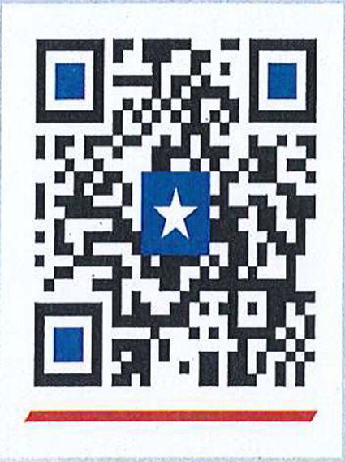
Sign Up For MyTMRS at tmrs.com
MyTMRS provides 24/7 online account access to:
  Designate your beneficiaries
  Update contact information
  Download account statements
  Run retirement benefit estimates
Notes:
Update with city name. Make sure it is clear that if they return before the 12 month break, their monthly benefit will be forfeited until they retire from the city again.

Slide 15
Designate and Update Your Beneficiary
Designating your beneficiary protects your family
Update your beneficiary after any life changes
Redesignate your beneficiary after you vest – a must

Slide 16
Designate and Update Your Beneficiary
Seriously, designate and update your beneficiary
Notes:
TMRS is always hear to answer your questions. We have an amazing Member Service Center that is available to answer your questions over the phone. You can also schedule a counseling session with a member of our Education team to discuss your account. Appointments are available before and after normal business hours and can be conducted by phone, through Zoom or in-person in our office in Austin. You can schedule a session by using this QR code to access the scheduling tool on our website. TMRS Information is also available 24/7 on tmrs.com and through MyTMRS. The easiest way to access MyTMRS is through the TMRS app. We are the only statewide retirement system in TMRS to have an app, so if you haven’t downloaded the app, do it today!

Slide 17
Run Benefit Estimates
Run monthly retirement benefit estimates on MyTMRS
Compare projected monthly retirement benefits using different retirement options and partial lump sum distributions
Notes:
TMRS is always hear to answer your questions. We have an amazing Member Service Center that is available to answer your questions over the phone. You can also schedule a counseling session with a member of our Education team to discuss your account. Appointments are available before and after normal business hours and can be conducted by phone, through Zoom or in-person in our office in Austin. You can schedule a session by using this QR code to access the scheduling tool on our website. TMRS Information is also available 24/7 on tmrs.com and through MyTMRS. The easiest way to access MyTMRS is through the TMRS app. We are the only statewide retirement system in TMRS to have an app, so if you haven’t downloaded the app, do it today!

Slide 18
Schedule a Counseling Session Online
Go to the Home Page at tmrs.com and click on “Schedule a Counseling Session Online”
Then schedule a virtual, phone or in-person counseling session with a Member Education Representative
You can review your TMRS account, benefit options, retirement paperwork, and more
Notes:
TMRS is always hear to answer your questions. We have an amazing Member Service Center that is available to answer your questions over the phone. You can also schedule a counseling session with a member of our Education team to discuss your account. Appointments are available before and after normal business hours and can be conducted by phone, through Zoom or in-person in our office in Austin. You can schedule a session by using this QR code to access the scheduling tool on our website. TMRS Information is also available 24/7 on tmrs.com and through MyTMRS. The easiest way to access MyTMRS is through the TMRS app. We are the only statewide retirement system in TMRS to have an app, so if you haven’t downloaded the app, do it today!

Slide 19
Have Questions?
Ida Gomez, Regional Representative
igomez@tmrs.com
O: 512-225-3748
M: 512-621-9559

