Slide 1
Agreement with Houston: Land Swap & Wastewater Treatment
May 19, 2025

Slide 2
Houston Needs Stormwater Detention
Houston needs land for stormwater detention near Keegan’s Bayou and wants to acquire Bellaire’s 76-acre Ruffino Tract for this purpose.
In June 2022, the parties signed an MOU for sale or long-term lease of the Ruffino Tract from Bellaire to Houston. Houston filed paperwork with TCEQ to allow it to excavate the closed landfill, but it did not have $11.6M to purchase the Ruffino Tract.
Negotiation stalled.
Notes:
Ruffino Tract located SW of Bellaire at US 69 and Sam Houston Tollroad near Keegans Bayou
In June 2022, Bellaire and Houston signed a “Ruffino Regional Detention Project Non-Binding Memorandum of Understanding”
Houston submitted the MOU as part of application package to Texas Division of Emergency Management for grant funding available through FEMA COVID hazard mitigation grant program
Houston submitted a Type IX Landfill Mining Registration Application to TCEQ for permission to excavate and relocate landfill material.
In December 2022, Houston approved the purchased West U's 73-acre Ruffino tract for $10.56M
In November 2023, Bellaire residents voted to removed "parkland" designation on our Ruffino Tract, clearing the way to sale.

Slide 3
Bellaire Needs Stormwater Detention
In December 2022, Bellaire hired Ardurra to manage our regional drainage program, including development of a project to expand the capacity of Cypress Ditch. This project requires stormwater detention.
Bellaire wants to acquire Houston’s approximately 13.15-acre Beechnut Tracts for this purpose, but we did not have $6.46M to purchase them – and the Beechnut Tracts alone do not meet project detention requirements.

Slide 4
Bellaire Needs Wastewater Treatment
In September 2023, Bellaire hired HDR to assess our WWTP. In July 2024, HDR advised that the WWTP is past its useful life and requires major rehab or replacement now.
Three options were presented:
Rehab/replace WWTP on existing site ($107M)
Construct new WWTP on adjacent site ($131.7M)
Decommission WWTP and connect to Houston ($11.48M)

Slide 5
Houston Has Wastewater Treatment
Houston’s Southwest WWTP is 800 feet away and has ample capacity to treat Bellaire’s wastewater flows. It is one of the larger plants in Houston’s system and is scheduled to undergo a major rehab at a cost of $250-350M within the next 5-7 years.
Bellaire could decommission our WWTP and connect to Houston’s Southwest WWTP for a fraction of the cost of rehabbing or replacing our WWTP – and doing so frees up 6.6 acres that Bellaire already owns for Cypress Ditch stormwater detention.
Notes:
Southwest Wastewater Treatment Plant:
Constructed in 1960s, significant facelift completed in 1986.
One of the larger plants in their WW system. Rated at 60 MGD, but currently limiting to around 41 MGD. Challenges with treating up to 60 MGD because relies on pure oxygen above the number they’re limiting. They are diverting flows elsewhere in the collection system when needed to ensure they don’t exceed the desired limit, which doesn’t require pure oxygen to treat.
Flooded 3-4 times and is “not in great shape.”
Do not have enough money to divert flows to Almeda Sims WWTP (FEMA negotiations for funding unsuccessful) therefore will be investing in this plant.
Two bid packages for a total of $250-305M in rehab and flood mitigation work pending. Work will touch almost every part of the plant, raise electrical and critical infrastructure above flood elevation, and include installation of a flood wall and gate. After these improvements, it will be “like a new plant.”
Currently working to replace existing bar screens and add 1-2 more, working on isolation gate, and will do a complete cleanout to improve current conditions. That work must be done before Bellaire can connect and is being performed on an accelerated schedule. They are committed to allowing us to connect in 2026, but additional time is helpful to them.
They have no issue with Bellaire connecting to the plant and said our flows are negligible. As long as we don’t have excessive I&I, don’t send industrial discharge, or cause major FOG issues, they’ll be no issues.
Don’t see decommissioning plant and diverting flows any time soon. If they did, Bellaire’s flows would go with (would already be committed).
Under consent decree, must pay stipulated penalties for any effluent violations. Because of that, no enforcement actions pending from TCEQ.

Slide 6
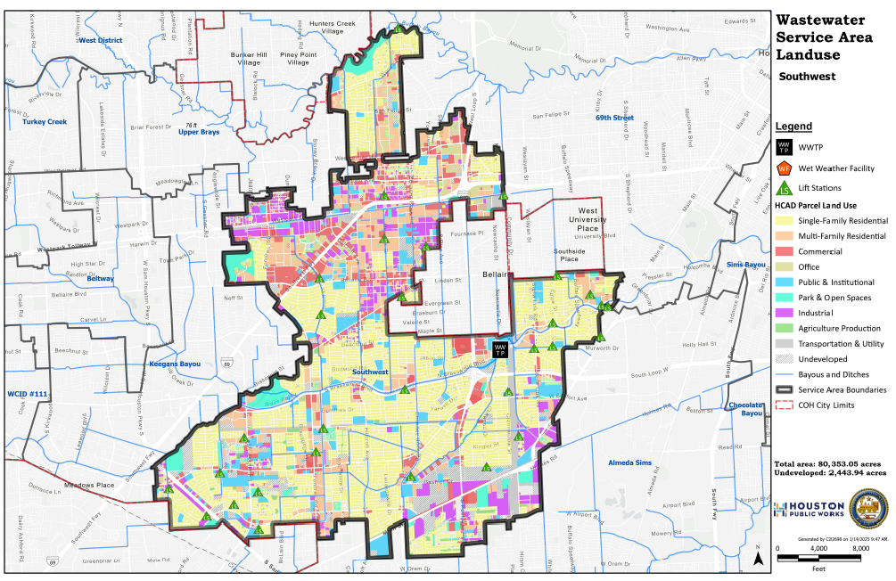

Slide 7
Purchase & Sale Agreement
Leverages parties’ respective assets to advance flood mitigation projects in Bellaire and Houston and consolidate neighboring WWTPs without the need for either party to cash-fund the transaction:
Bellaire will convey Ruffino Tract to Houston.
Houston will convey Beechnut Tracts to Bellaire.
Houston will contract with Bellaire to treat Bellaire’s wastewater.
Houston will freeze impact fee to 2025 rate.
Houston will credit Bellaire $5.14M against impact fee.

Slide 8
Sanitary Sewer Service Agreement
Term of 100 years (40 years, plus three 20-year auto renewals).
Bellaire has the option to terminate with notice.
Bellaire must pay an impact fee at time of connection; payment reserves capacity to Bellaire.
Bellaire must pay published rate applicable to contract customers.
Houston responsible for treating Bellaire’s wastewater and complying with environmental laws and regulations related to treatment.
Bellaire remains responsible for wastewater collection system, customer service, and billing.

Slide 9
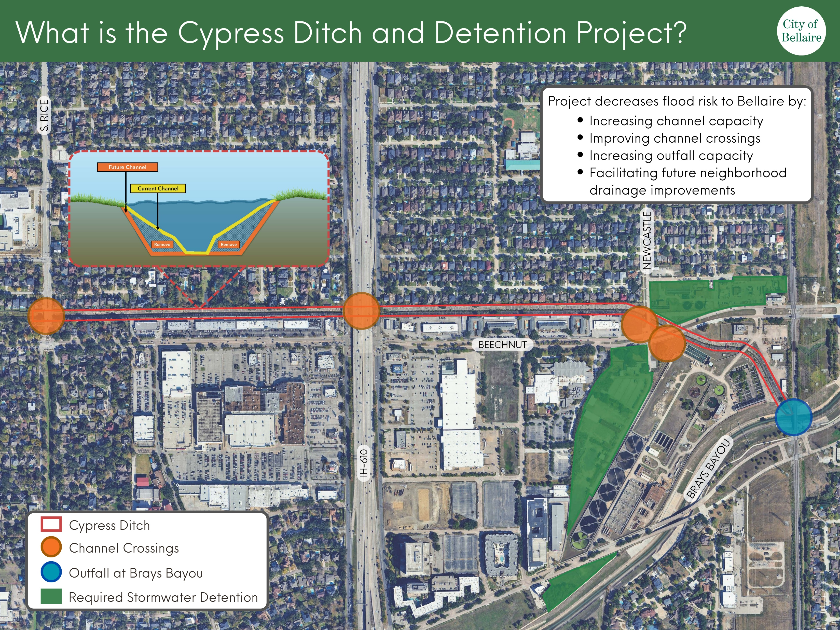
Notes:
Cypress Ditch runs along the north side of Beechnut. The project will expand the channel capacity and channel crossings (depicted in orange) from S. Rice to its outfall into Brays Bayou (depicted in blue). The stormwater detention south of Beechnut and West of Newcastle (depicted in green) is the Beechnut Tracts, which total 13.15 acres. The stormwater detention north of Beechnut and east of Newcastle (also depicted in green) is the WWTP site and PW Laydown yard. That area is approximately 6.6 acres.

Slide 10
Decision Point Regarding Wastewater
If Bellaire executes the Purchase & Sale Agreement, we should be committed to decommissioning the WWTP and connecting to Houston.
If we do not connect to Houston, $5.14M impact fee credit has no value.

Slide 11
Alternatives
Bellaire could convey Ruffino Tract to Houston for Beechnut Tracts and seek a credit against surface water bill, but this alternative does not address Bellaire’s need for wastewater treatment. Remaining wastewater treatment options are much more expensive.
Bellaire could sell Ruffino Tract to another buyer, but this alternative does not address Bellaire’s need for land for stormwater detention or wastewater treatment. Bellaire would need to negotiate with Houston for both or select a more expensive wastewater treatment option.

Slide 12
Recommendation
Staff recommends that Bellaire execute the Purchase & Sale Agreement with Houston to secure land for stormwater detention for the Cypress Ditch project, and to secure a cost-effective solution to our wastewater treatment needs for a period of up to 100 years.

Slide 13
Questions & Discussion
May 19, 2025

